Slide 1
The Relational Algebra
Copyright © 2007 Ramez Elmasri and Shamkant B. Navathe

Slide 2
Chapter Outline
Relational Algebra
  Unary Relational Operations
  Relational Algebra Operations From Set Theory
  Binary Relational Operations
  Additional Relational Operations
  Examples of Queries in Relational Algebra
Slide 6- <number>

Slide 3
Relational Algebra Overview
Relational algebra is the basic set of operations for the relational model
These operations enable a user to specify basic retrieval requests (or queries)
The result of an operation is a new relation, which may have been formed from one or more input relations
  This property makes the algebra “closed” (all objects in relational algebra are relations)
Slide 6- <number>

Slide 4
Relational Algebra Overview (continued)
The algebra operations thus produce new relations
  These can be further manipulated using operations of the same algebra
A sequence of relational algebra operations forms a relational algebra expression
  The result of a relational algebra expression is also a relation that represents the result of a database query (or retrieval request)
Slide 6- <number>

Slide 5
Relational Algebra Overview
Relational Algebra consists of several groups of operations
  Unary Relational Operations
    SELECT (symbol: σ (sigma))
    PROJECT (symbol: π (pi))
    RENAME (symbol: ρ (rho))
  Relational Algebra Operations From Set Theory
    UNION ( ∪ ), INTERSECTION ( ∩ ), DIFFERENCE (or MINUS, – )
    CARTESIAN PRODUCT ( x )
  Binary Relational Operations
    JOIN (several variations of JOIN exist)
    DIVISION
  Additional Relational Operations
    OUTER JOINS, OUTER UNION
    AGGREGATE FUNCTIONS (These compute summary of information: for example, SUM, COUNT, AVG, MIN, MAX)
Slide 6- <number>

Slide 6

Database State for COMPANY
All examples discussed below refer to the COMPANY database shown here.
Slide 6- <number>

Slide 7
Unary Relational Operations: SELECT
The SELECT operation (denoted by σ (sigma)) is used to select a subset of the tuples from a relation based on a selection condition.
  The selection condition acts as a filter
  Keeps only those tuples that satisfy the qualifying condition
  Tuples satisfying the condition are selected whereas the other tuples are discarded (filtered out)
Examples:
  Select the EMPLOYEE tuples whose department number is 4:
σ _{DNO = 4} (EMPLOYEE)
  Select the employee tuples whose salary is greater than $30,000:
σ _{SALARY > 30,000} (EMPLOYEE)
Slide 6- <number>

Slide 8
Unary Relational Operations: SELECT
  In general, the select operation is denoted by σ _{<selection condition>}(R) where
    the symbol σ (sigma) is used to denote the select operator
    the selection condition is a Boolean (conditional) expression specified on the attributes of relation R
    tuples that make the condition true are selected
      appear in the result of the operation
    tuples that make the condition false are filtered out
      discarded from the result of the operation
Slide 6- <number>

Slide 9
Unary Relational Operations: SELECT (contd.)
SELECT Operation Properties
  The SELECT operation σ _{<selection condition>}(R) produces a relation S that has the same schema (same attributes) as R
  SELECT σ is commutative:
    σ _{<condition1>}(σ _{< condition2>} (R)) = σ _{<condition2>} (σ _{< condition1>} (R))
  Because of commutativity property, a cascade (sequence) of SELECT operations may be applied in any order:
    σ_{<cond1>}(σ_{<cond2>} (σ_{<cond3>} (R)) = σ_{<cond2>} (σ_{<cond3>} (σ_{<cond1>} ( R)))
  A cascade of SELECT operations may be replaced by a single selection with a conjunction of all the conditions:
    σ_{<cond1>}(σ_{< cond2>} (σ_{<cond3>}(R)) = σ <cond1> AND < cond2> AND < cond3>(R)))
  The number of tuples in the result of a SELECT is less than (or equal to) the number of tuples in the input relation R
Slide 6- <number>

Slide 10

The following query results refer to this database state
Slide 6- <number>

Slide 11
Unary Relational Operations: PROJECT
PROJECT Operation is denoted by π (pi)
This operation keeps certain columns (attributes) from a relation and discards the other columns.
  PROJECT creates a vertical partitioning
    The list of specified columns (attributes) is kept in each tuple
    The other attributes in each tuple are discarded
Example: To list each employee’s first and last name and salary, the following is used:
  π_{LNAME, FNAME,SALARY}(EMPLOYEE)
Slide 6- <number>

Slide 12
Unary Relational Operations: PROJECT (cont.)
The general form of the project operation is:
π_{<attribute list>}(R)
  π (pi) is the symbol used to represent the project operation
  <attribute list> is the desired list of attributes from relation R.
The project operation removes any duplicate tuples
  This is because the result of the project operation must be a set of tuples
    Mathematical sets do not allow duplicate elements.
Slide 6- <number>

Slide 13
Unary Relational Operations: PROJECT (contd.)
PROJECT Operation Properties
  The number of tuples in the result of projection π_{<list>}(R) is always less or equal to the number of tuples in R
    If the list of attributes includes a key of R, then the number of tuples in the result of PROJECT is equal to the number of tuples in R
  PROJECT is not commutative
    π _{<list1>} (π _{<list2>} (R) ) = π _{<list1>} (R) as long as <list2> contains the attributes in <list1>
Slide 6- <number>

Slide 14
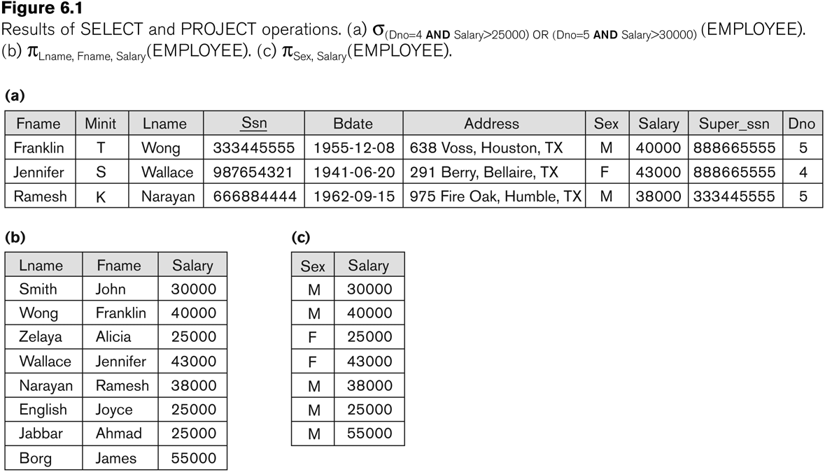
Examples of applying SELECT and PROJECT operations
Slide 6- <number>

Slide 15
Relational Algebra Expressions
We may want to apply several relational algebra operations one after the other
  Either we can write the operations as a single relational algebra expression by nesting the operations, or
  We can apply one operation at a time and create intermediate result relations.
In the latter case, we must give names to the relations that hold the intermediate results.
Slide 6- <number>

Slide 16
Single expression versus sequence of relational operations (Example)
To retrieve the first name, last name, and salary of all employees who work in department number 5, we must apply a select and a project operation
We can write a single relational algebra expression as follows:
  π_{FNAME, LNAME, SALARY}(σ _{DNO=5}(EMPLOYEE))
OR We can explicitly show the sequence of operations, giving a name to each intermediate relation:
  DEP5_EMPS ← σ _{DNO=5}(EMPLOYEE)
  RESULT ← π _{FNAME, LNAME, SALARY} (DEP5_EMPS)
Slide 6- <number>

Slide 17
Unary Relational Operations: RENAME
The RENAME operator is denoted by ρ (rho)
In some cases, we may want to rename the attributes of a relation or the relation name or both
  Useful when a query requires multiple operations
  Necessary in some cases (see JOIN operation later)
Slide 6- <number>

Slide 18
Unary Relational Operations: RENAME (contd.)
The general RENAME operation ρ can be expressed by any of the following forms:
  ρ_{S (B1, B2, …, Bn )}(R) changes both:
    the relation name to S, and
    the column (attribute) names to B1, B1, …..Bn
  ρ_{S}(R) changes:
    the relation name only to S
  ρ_{(B1, B2, …, Bn )}(R) changes:
    the column (attribute) names only to B1, B1, …..Bn
Slide 6- <number>

Slide 19
Unary Relational Operations: RENAME (contd.)
For convenience, we also use a shorthand for renaming attributes in an intermediate relation:
  If we write:
    RESULT ← π _{FNAME, LNAME, SALARY} (DEP5_EMPS)
    RESULT will have the same attribute names as DEP5_EMPS (same attributes as EMPLOYEE)
  If we write:
    RESULT (F, M, L, S, B, A, SX, SAL, SU, DNO)← π _{FNAME, LNAME, SALARY} (DEP5_EMPS)
    The 10 attributes of DEP5_EMPS are renamed to F, M, L, S, B, A, SX, SAL, SU, DNO, respectively
Slide 6- <number>

Slide 20
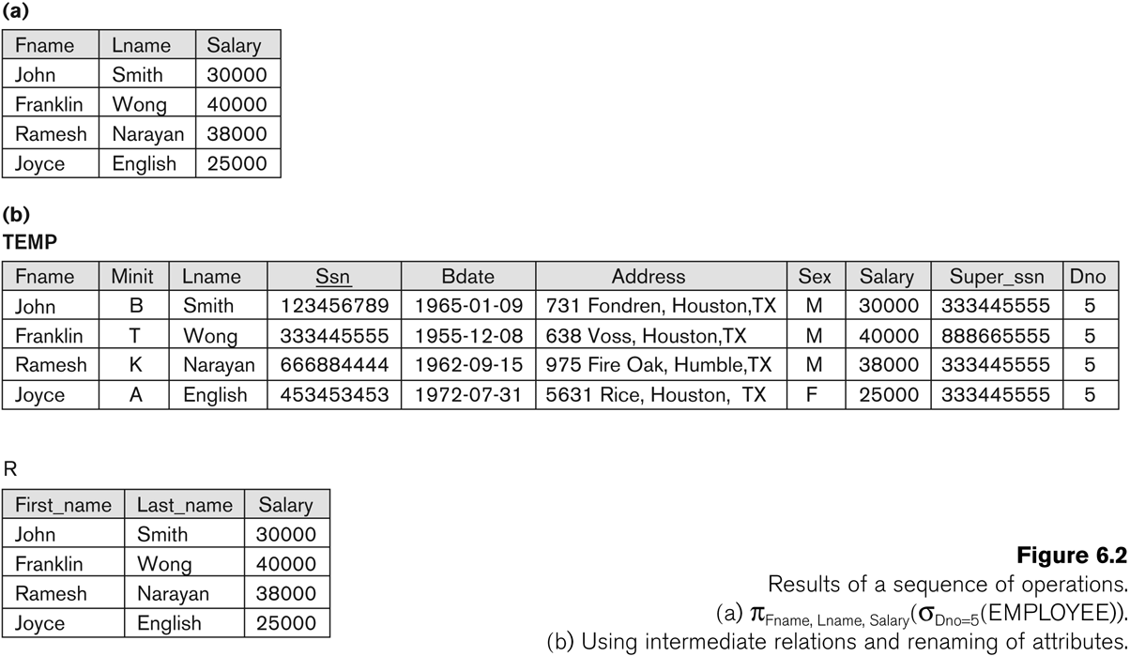
Example of applying multiple operations and RENAME
Slide 6- <number>

Slide 21
Relational Algebra Operations from
Set Theory: UNION
UNION Operation
  Binary operation, denoted by ∪
  The result of R ∪ S, is a relation that includes all tuples that are either in R or in S or in both R and S
  Duplicate tuples are eliminated
  The two operand relations R and S must be “type compatible” (or UNION compatible)
    R and S must have same number of attributes
    Each pair of corresponding attributes must be type compatible (have same or compatible domains)
Slide 6- <number>

Slide 22
Relational Algebra Operations from
Set Theory: UNION
Example:
  To retrieve the social security numbers of all employees who either work in department 5 (RESULT1 below) or directly supervise an employee who works in department 5 (RESULT2 below)
  We can use the UNION operation as follows:
DEP5_EMPS ← σ_{DNO=5} (EMPLOYEE)
RESULT1 ← π _{SSN}(DEP5_EMPS)
RESULT2(SSN) ← π_{SUPERSSN}(DEP5_EMPS)
RESULT ← RESULT1 ∪ RESULT2
  The union operation produces the tuples that are in either RESULT1 or RESULT2 or both
Slide 6- <number>

Slide 23
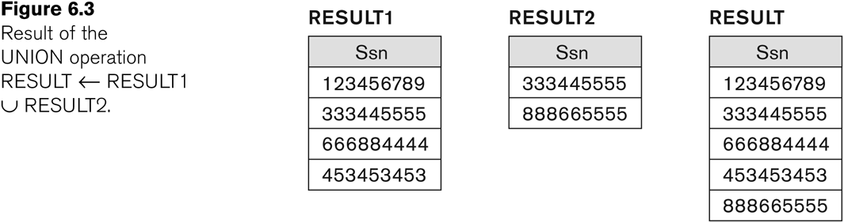
Example of the result of a UNION operation
UNION Example
Slide 6- <number>

Slide 24
Relational Algebra Operations from
Set Theory
Type Compatibility of operands is required for the binary set operation UNION ∪, (also for INTERSECTION ∩, and SET DIFFERENCE –, see next slides)
R1(A1, A2, ..., An) and R2(B1, B2, ..., Bn) are type compatible if:
  they have the same number of attributes, and
  the domains of corresponding attributes are type compatible (i.e. dom(Ai)=dom(Bi) for i=1, 2, ..., n).
The resulting relation for R1∪R2 (also for R1∩R2, or R1–R2, see next slides) has the same attribute names as the first operand relation R1 (by convention)
Slide 6- <number>

Slide 25
Relational Algebra Operations from Set Theory: INTERSECTION
INTERSECTION is denoted by ∩
The result of the operation R ∩ S, is a relation that includes all tuples that are in both R and S
  The attribute names in the result will be the same as the attribute names in R
The two operand relations R and S must be “type compatible”
Slide 6- <number>

Slide 26
Relational Algebra Operations from Set Theory: SET DIFFERENCE (cont.)
SET DIFFERENCE (also called MINUS or EXCEPT) is denoted by –
The result of R – S, is a relation that includes all tuples that are in R but not in S
  The attribute names in the result will be the same as the attribute names in R
The two operand relations R and S must be “type compatible”
Slide 6- <number>

Slide 27
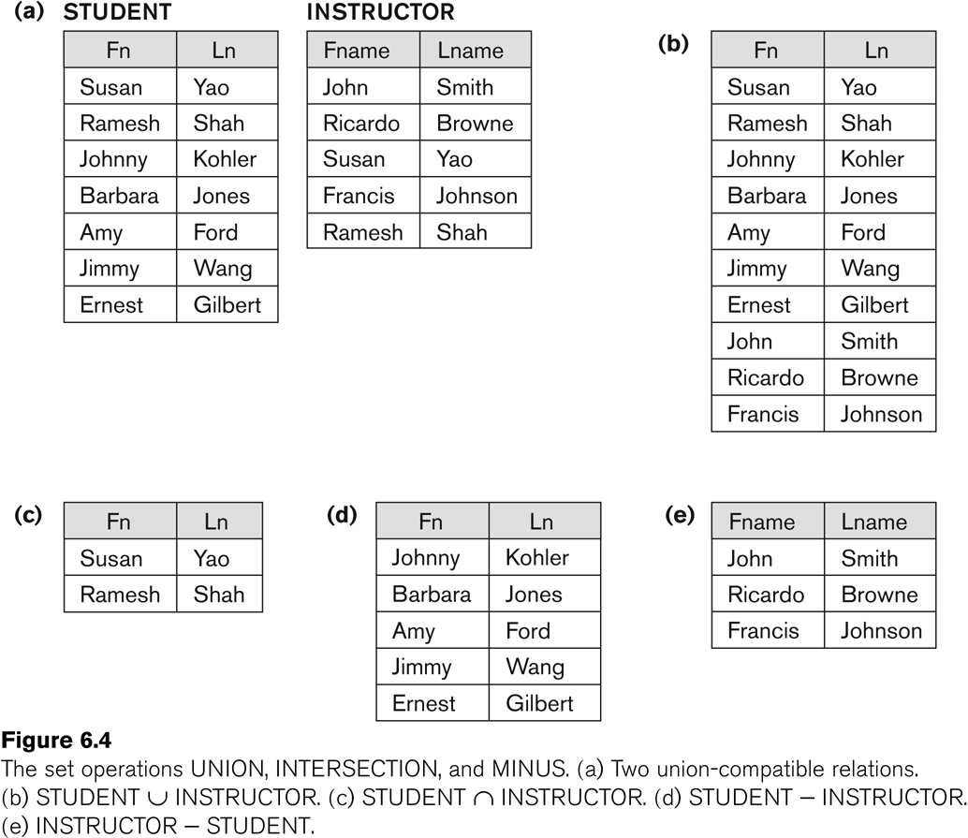
Example to illustrate the result of UNION, INTERSECT, and DIFFERENCE
Slide 6- <number>

Slide 28
Some properties of UNION, INTERSECT, and DIFFERENCE
Notice that both union and intersection are commutative operations; that is
  R ∪ S = S ∪ R, and R ∩ S = S ∩ R
Both union and intersection can be treated as n-ary operations applicable to any number of relations as both are associative operations; that is
  R ∪ (S ∪ T) = (R ∪ S) ∪ T
  (R ∩ S) ∩ T = R ∩ (S ∩ T)
The minus operation is not commutative; that is, in general
  R – S ≠ S – R
Slide 6- <number>

Slide 29
Relational Algebra Operations from Set Theory: CARTESIAN PRODUCT
CARTESIAN (or CROSS) PRODUCT Operation
  This operation is used to combine tuples from two relations in a combinatorial fashion.
  Denoted by R(A1, A2, . . ., An) x S(B1, B2, . . ., Bm)
  Result is a relation Q with degree n + m attributes:
    Q(A1, A2, . . ., An, B1, B2, . . ., Bm), in that order.
  The resulting relation state has one tuple for each combination of tuples—one from R and one from S.
  Hence, if R has n_{R} tuples (denoted as |R| = n_{R} ), and S has n_{S} tuples, then R x S will have n_{R} * n_{S} tuples.
  The two operands do NOT have to be "type compatible”
Slide 6- <number>

Slide 30
Join Operation
Join is a commonly used sequence of operators
  Take the Cartesian product of two relations
  Select only related tuples
  (Possibly) eliminate duplicate columns
3753 X2 - 2003

Slide 31
Join Example
R = S =
R1 ← R X S
R2 ← σ _{dcode = code} (R1)
Result ← π _{code, office, number} (R2)
dcode | number
COMP | 555-1111
HIST | 555-2222
code | office
COMP | CAR309
HIST | BAC333
3753 X2 - 2003

Slide 32
Join Example (cont’d)
You could do all of that, or you could do a join
Result ← R ⋈ _{dcode = code} S
3753 X2 - 2003

Slide 33
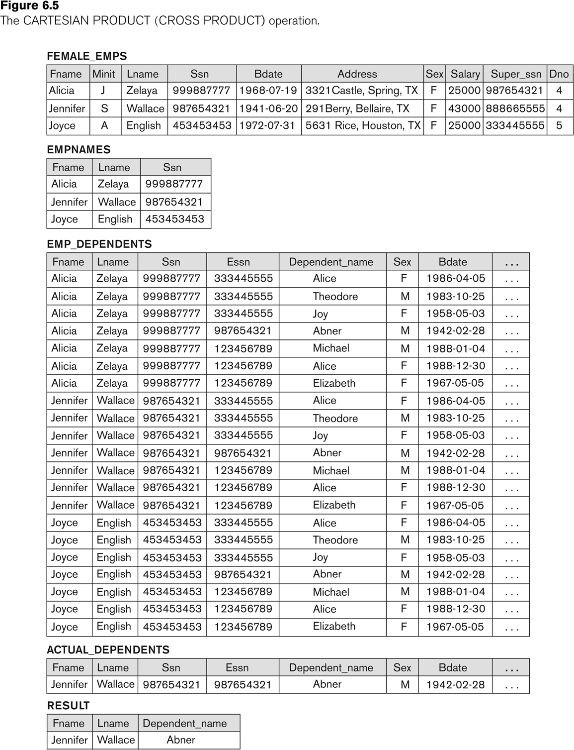
Example of applying CARTESIAN PRODUCT
Slide 6- <number>

Slide 34
Binary Relational Operations: JOIN
JOIN Operation (denoted by )
  The sequence of CARTESIAN PRODECT followed by SELECT is used quite commonly to identify and select related tuples from two relations
  A special operation, called JOIN combines this sequence into a single operation
  This operation is very important for any relational database with more than a single relation, because it allows us combine related tuples from various relations
  The general form of a join operation on two relations R(A1, A2, . . ., An) and S(B1, B2, . . ., Bm) is:
  R _{<join condition>}S
  where R and S can be any relations that result from general relational algebra expressions.
Slide 6- <number>

Slide 35
Binary Relational Operations: JOIN (cont.)
Example: Suppose that we want to retrieve the name of the manager of each department.
  To get the manager’s name, we need to combine each DEPARTMENT tuple with the EMPLOYEE tuple whose SSN value matches the MGRSSN value in the department tuple.
  We do this by using the join operation.
  DEPT_MGR ← DEPARTMENT _{MGRSSN=SSN} EMPLOYEE
MGRSSN=SSN is the join condition
  Combines each department record with the employee who manages the department
  The join condition can also be specified as DEPARTMENT.MGRSSN= EMPLOYEE.SSN
Slide 6- <number>

Slide 36
Types of Joins
Left Outer Join
  keep all of the tuples from the “left” relation
  join with the right relation
  pad the non-matching tuples with nulls
Right Outer Join
  same as the left, but keep tuples from the “right” relation
Full Outer Join
  same as left, but keep all tuples from both relations
3753 X2 - 2003

Slide 37

Left Outer Join
name phone
name email
A | B
C | D
A | F
G | H
R=
S=
If we do a left outer join on R and S, and we match on the first column, the result is:
Result= R _{R.name=S.name} S
name phone email
A | B | F
C | D | -
3753 X2 - 2003

Slide 38
Right Outer Join
name phone
name email
A | B
C | D
A | F
G | H
R=
S=
If we do a right outer join on R and S, and we match on the first column, the result is:
Result= R _{R.name=S.name} S
name phone email
A | B | F
G | - | H

Slide 39
Full Outer Join
name phone
name email
A | B
C | D
A | F
G | H
R=
S=
If we do a full outer join on R and S, and we match on the first column, the result is:
name phone email
A | B | F
C | D | -
G | - | H
3753 X2 - 2003

Slide 40
Additional Relational Operations (cont.)
The left outer join operation keeps every tuple in the first or left relation R in R S; if no matching tuple is found in S, then the attributes of S in the join result are filled or “padded” with null values.
A similar operation, right outer join, keeps every tuple in the second or right relation S in the result of R S.
A third operation, full outer join, denoted by keeps all tuples in both the left and the right relations when no matching tuples are found, padding them with null values as needed.
Slide 6- <number>

Slide 41
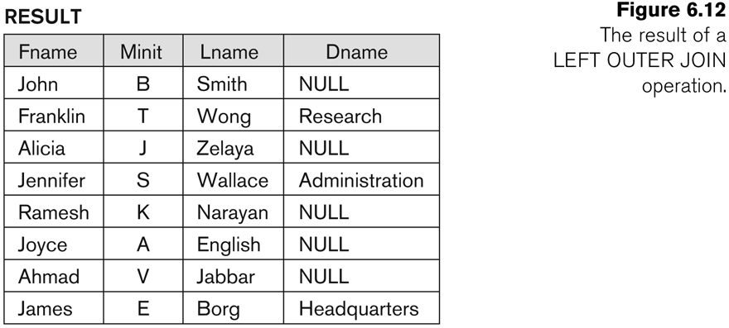
Additional Relational Operations (cont.)
Slide 6- <number>

Slide 42
Additional Relational Operations: Aggregate Functions and Grouping
A type of request that cannot be expressed in the basic relational algebra is to specify mathematical aggregate functions on collections of values from the database.
Examples of such functions include retrieving the average or total salary of all employees or the total number of employee tuples.
  These functions are used in simple statistical queries that summarize information from the database tuples.
Common functions applied to collections of numeric values include
  SUM, AVERAGE, MAXIMUM, and MINIMUM.
The COUNT function is used for counting tuples or values.
Slide 6- <number>

Slide 43
Aggregate Function Operation
Use of the Aggregate Functional operation ℱ
  ℱ_{MAX Salary} (EMPLOYEE) retrieves the maximum salary value from the EMPLOYEE relation
  ℱ_{MIN Salary} (EMPLOYEE) retrieves the minimum Salary value from the EMPLOYEE relation
  ℱ_{SUM Salary} (EMPLOYEE) retrieves the sum of the Salary from the EMPLOYEE relation
  ℱ_{COUNT SSN, AVERAGE Salary} (EMPLOYEE) computes the count (number) of employees and their average salary
    Note: count just counts the number of rows, without removing duplicates
Slide 6- <number>

Slide 44
Using Grouping with Aggregation
The previous examples all summarized one or more attributes for a set of tuples
  Maximum Salary or Count (number of) Ssn
Grouping can be combined with Aggregate Functions
Example: For each department, retrieve the DNO, COUNT SSN, and AVERAGE SALARY
A variation of aggregate operation ℱ allows this:
  Grouping attribute placed to left of symbol
  Aggregate functions to right of symbol
  _{DNO} ℱ_{COUNT SSN, AVERAGE Salary} (EMPLOYEE)
Above operation groups employees by DNO (department number) and computes the count of employees and average salary per department
Slide 6- <number>

Slide 45
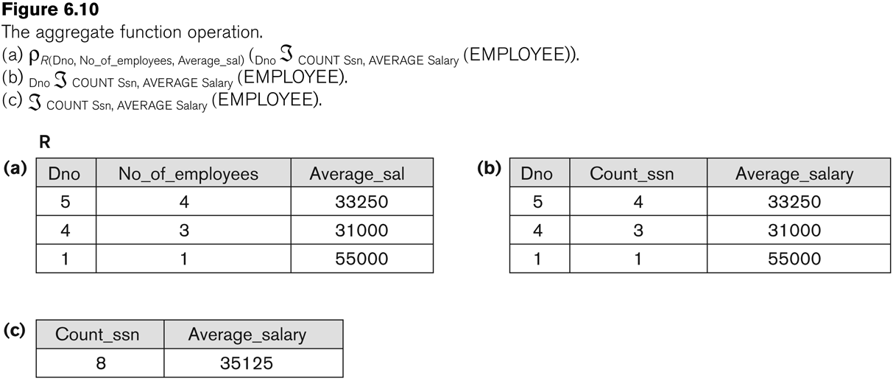
Examples of applying aggregate functions and grouping
Slide 6- <number>

Slide 46
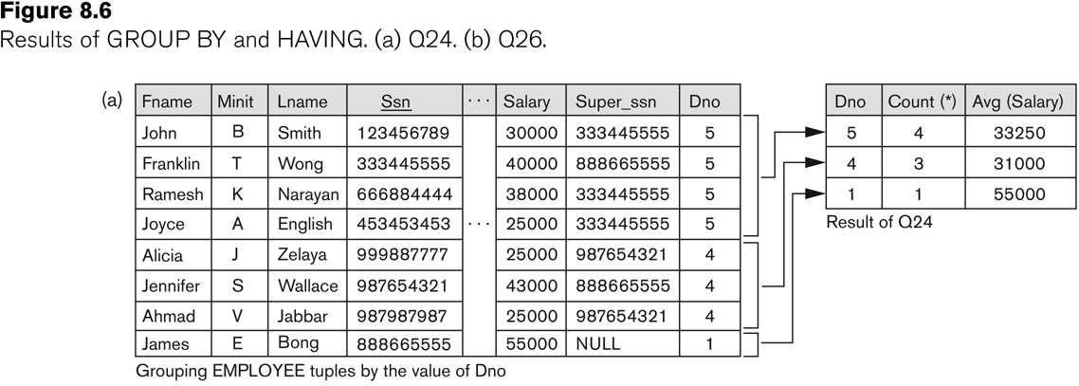
Illustrating aggregate functions and grouping
Slide 6- <number>

Slide 47
if we want to find the information for Regular Class and Extra Class which are conducted during morning, then, we can use the following operation:
σ_{time = 'morning'} (RegularClass _{Rsid=Esid} ExtraClass)
∏_{Studentname (}σ_{time = 'morning'} (RegularClass _{Rsid=Esid} ExtraClass))
Slide 6- <number>

